Slide 1


"The Impact of Remote Work on Employees' Mental Well-being."
Mind Over Monitor:
Mental Well-being in the Age of Remote Work

Slide 2
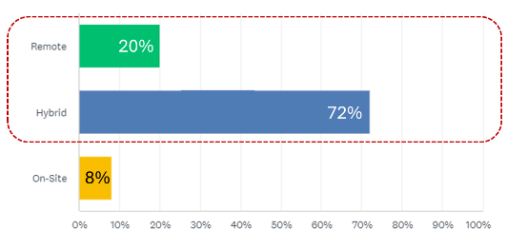
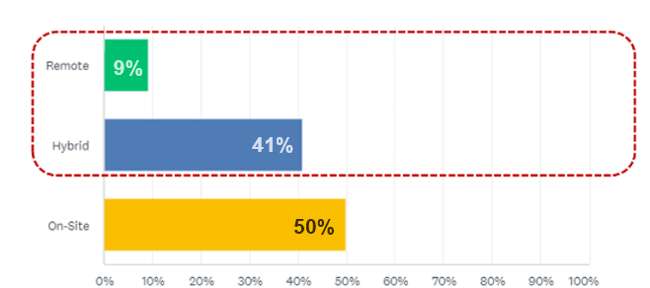
Survey Results
Preferred vs. Actual Work Modes
50%
92%
92%
50%
Notes:
This slide includes animation to transition between the percentages and results.
We invited the entire MBAN cohort to answer a simple survey to report their preferences on work arrangement after graduating from the MBAN program.
The results showed that 92% of the respondents would like to have remote or hybrid jobs.
In reality, for students who have worked prior to joining the MBAN program, only 50% of the respondents had remote or hybrid jobs.

Slide 3

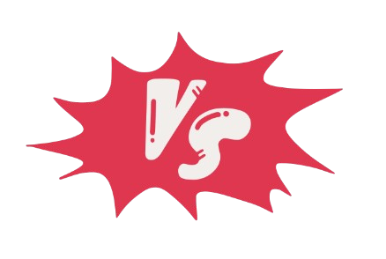
Expectations
Employee
Company
Employer
Work-Life Balance
Productivity/Innovation
Better life balance
Maintaining productivity
Flexibility
Freedom in work location and hours
Cost-efficiency
(e.g. office space)
Social Interaction
Need for social engagement
Culture sustainability
Executive Manager
General Manager
Productivity
Personal efficiency in preferred setting
Boosting employee and performance
Development & Retention
Career growth and job satisfaction
Talent retention and development
Notes:
Employee and employer expectations in work arrangements often differ in scope and focus. This slide highlights key expectations across various areas, illustrating a 'tug-of-war' dynamic between the two perspectives.

Slide 4
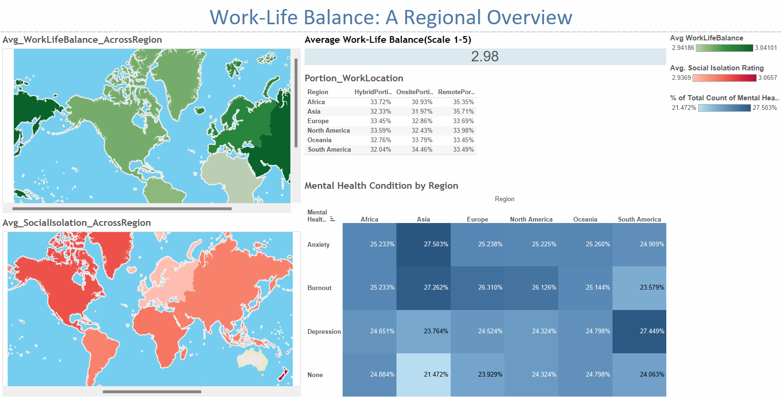
Notes:
We are taking a closer look from the employee’s perspective by using a dataset from Kaggle. The dataset contains 5,000 records gathered from an online survey on work arrangement and mental well-being metrics. We performed high-level analysis with multiple regression and found no significant impact of features on mental health conditions. We think lack of statistical significance is due to data collection and features dependency. So, we took a different approach in segmenting the data and took a closer look at regions and industries.
The interactive Dashboard in Tableau shows the Work-Life Balance measure by a regional overview. This slide includes a screenshot from Tableau.

Slide 5
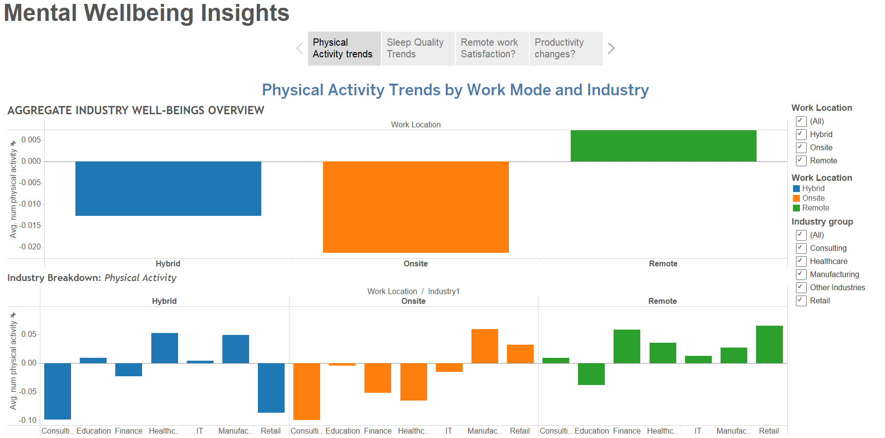
Notes:
The Story in Tableau shows various insights on mental well-being metrics in different work arrangements.
This slide features the screenshot of Physical Activity Trends by Work Mode and Industry.

Slide 6
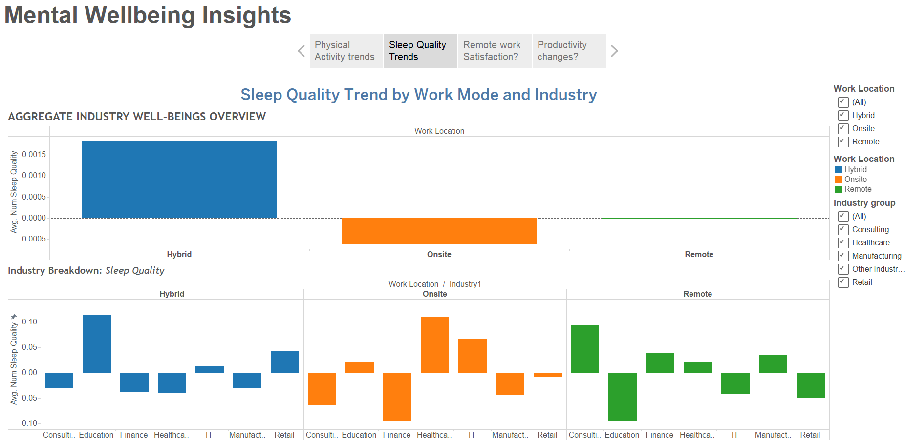
Notes:
The Story in Tableau shows various insights on mental well-being metrics in different work arrangements.
This slide features the screenshot of Sleep Quality Trends by Work Mode and Industry.

Slide 7
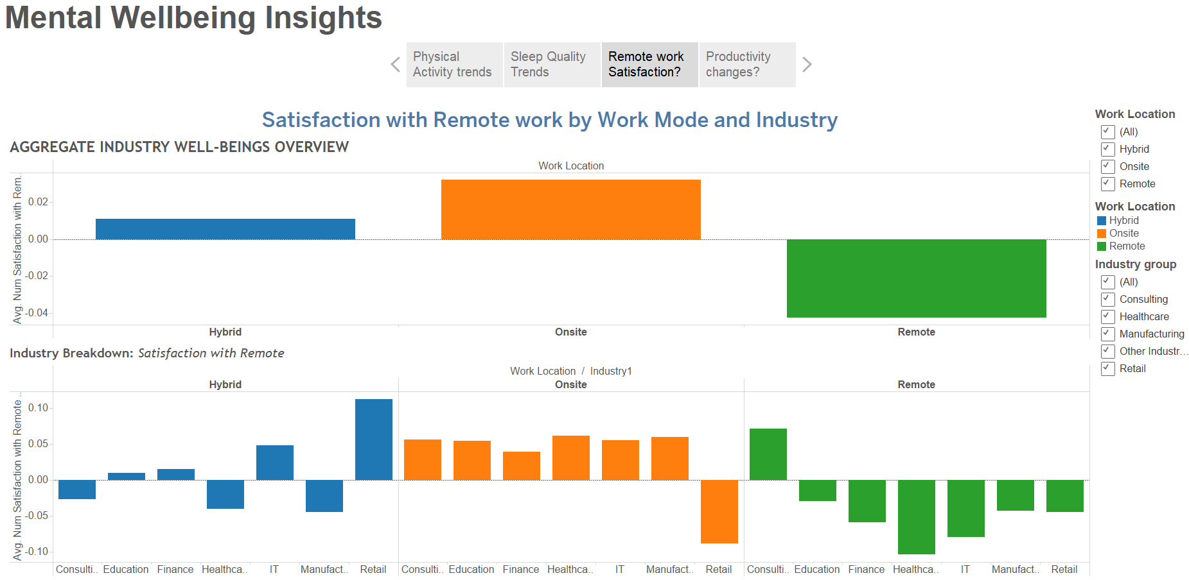
Notes:
The Story in Tableau shows various insights on mental well-being metrics in different work arrangements.
This slide features the screenshot of Satisfaction with Remote work by Work Mode and Industry.

Slide 8
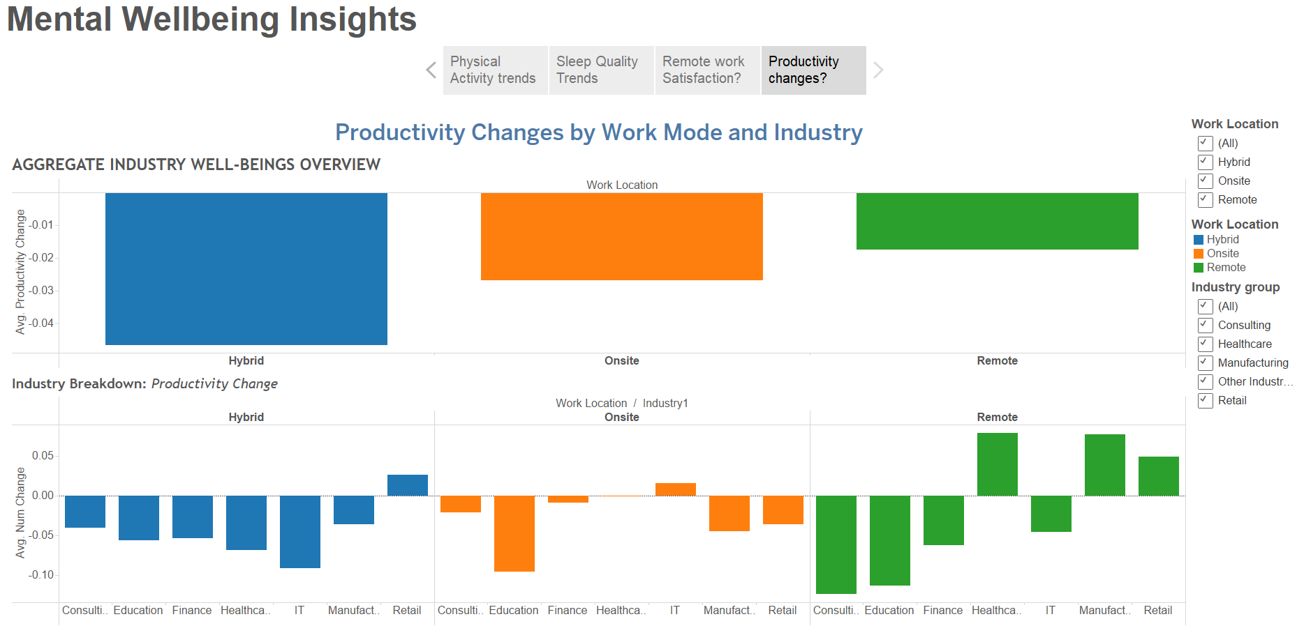
Notes:
The Story in Tableau shows various insights on mental well-being metrics in different work arrangements.
This slide features the screenshot of Productivity Changes by Work Mode and Industry.

Slide 9
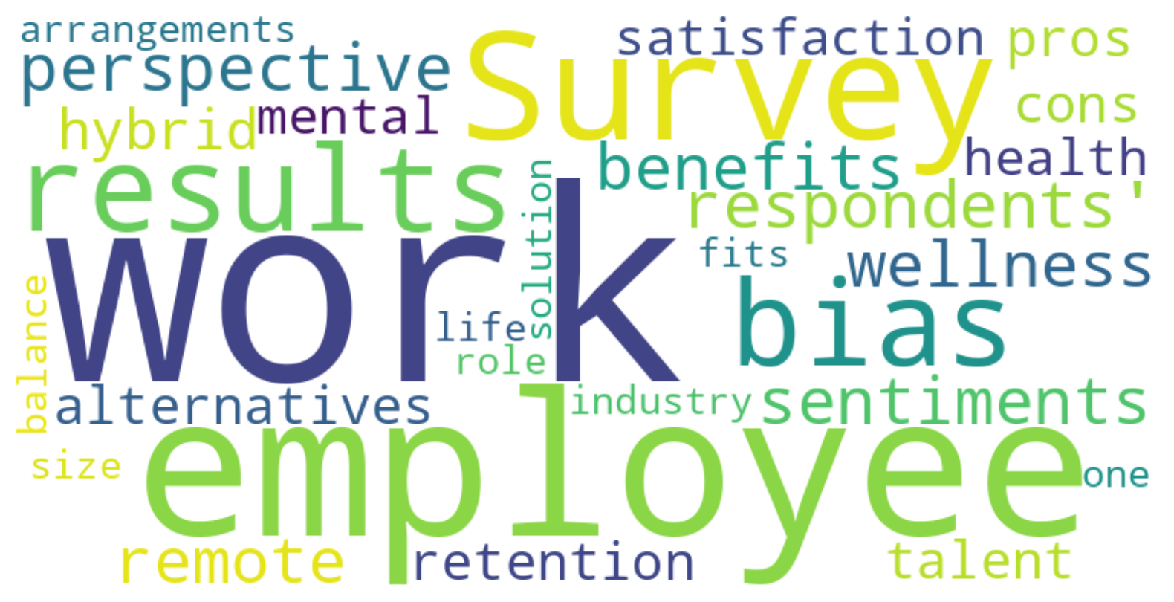
GALLERY
Notes:
Conclusion:
Our analysis reveals various insights on work arrangement preferences, some of which align with our initial expectations and others do not. This shows the complexity of determining what is considered the “best” type of work arrangement. It is also important to consider potential bias in survey results, which may reflect respondents' sentiments at the time.
From employees’ perspective, key considerations include mental well-being and work-life-balance. However, many employees may lack full awareness of all the pros and cons.
From employers’ perspective, multiple factors should be considered when designing work arrangements, such as talent retention and employees’ job satisfaction.
Ultimately, there is no one-size-fit-all solution, as the ideal work arrangement depends heavily on the specific industry, role, and each person’s individual needs and mental well-being.

Slide 10

BA2 Group 7
Alberto Dussan Ruiz 26091363
Kristen Fang 13694393
Saloni Gharge 55859177
Yijia Wan 67841304
Sara Wong 50313501
Bohan Yue 37095650
THANK
YOU!

